Slide 1
Web app interface design
User Interface Design
Reporters: Janxent Maverick P. Agner
Jhon Grey Asis

Slide 2
Introduction
More and more applications these days are migrating to the Web. Without platform constraints or installation requirements, the Software-as-a-Service (SaaS) model looks very attractive. Web application interface design is, at its core, Web design; however, its focus is mainly on function. To compete with desktop applications, Web apps must offer simple, intuitive and responsive user interfaces that let their users get things done with less effort and time.
Notes:
By the way software as a service (SaaS) is a cloud provider that hosts the application and makes them available to end users over the internet.

Slide 3
THE WEB APP INTERFACE SHOULD ANSWER THE THREE PRIMARY QUESTIONS FOR THE END USER
Where am I?
What can I do now?
Where have I been, where am I going?
Notes:
By the way, the end user is the person who actually uses a particular product.
Where am I?
- there are two things to consider (1) The interface should provide an indication of the WebApp that has been accessed and (2) inform the user of his location in the content hierarchy.
- Ini nga question. Usa ini nga importante nga part han user experience kay, nabulig ini nga maintindihan han mga magamit kun hain na hira ha sulod han web app interface ngan paano hira mabalik han ira previous actions.
for example, kun ada kita ha usa ka website nga mayda damo nga mga pages, dapat dire malipat an user kon hain na hiya ha sulod han website - ha homepage ba, ha contact page, or anywhere inside the site.
- in short, when the user open the web app interface, it should be easy to navigate, so the user will know in which part of the page he is.
What can I do now?
- The interface should always help the user understand his current options—what functions are available, what links are live, what content is relevant.
- for example:
Let's say you're using an online banking web app. After logging in, you're taken to the homepage where you can view your account balance, recent transactions, and other account details. At the top of the page, you see a button labeled "Transfer Money". This is where the "What can I do now?" question comes into play.
By clicking on the "Transfer Money" button, you are given the option to transfer funds between your accounts or to other people's accounts. This gives you a clear idea of what actions you can take at that moment in the interface. The "What can I do now?" question helps guide the user through the app and encourages them to explore the different features available to them.
Where have I been, Where am I going?
- The interface must facilitate navigation. Hence, it must provide a “map” (implemented in a way that is easy to understand) of where the user has been and what paths may be taken to move elsewhere within the WebApp.
Over all, it is likely that users may enter your WebApp at various locations and levels in the content hierarchy, be sure to design every page with navigation features that will lead the user to other points of interest.

Slide 4
Interface Design Principles and Guidelines

Slide 5
The user interface of a WebApp is its “first impression.” Regardless of the value of its content, the sophistication of its processing capabilities and services, and the overall benefit of the WebApp itself, a poorly designed interface will disappoint the potential user and may, in fact, cause the user to go elsewhere. Because of the sheer volume of competing Web Apps in virtually every subject area, the interface must “grab” a potential user immediately. Bruce Tognozzi [Tog01] defines a set of fundamental characteristics that all interfaces should exhibit and in doing so, establishes a philosophy that should be followed by every WebApp interface designer:
Visually apparent
Hide inner workings of the system
Maximum of work
Notes:
“If a site is perfectly usable but it lacks an elegant and appropriate design style, it will fail.”
In short, if! the interface is attracting or appealing to the eye of the user, then! they will continue, else! the user they might get bored.
Visually apparent
- Effective interfaces are visually apparent and forgiving, instilling in their users a sense of control. Users quickly see the breadth of their options, grasp how to achieve their goals, and do their work.
- it should be visually appealing to the users, that is a first thing, how the objects are placed, how the menus are placed, it should be appealing to the users. Kun baga, maupay ba kitaon.
Hide inner workings of the system
- Effective interfaces do not concern the user with the inner workings of the system. Work is carefully and continuously saved, with full option for the user to undo any activity at any time.
- what are the inner details of the interface, workings and functionalities, its not necessary that the user has to know, so the transparency is maintained.
Maximum of work
- Effective applications and services perform a maximum of work, while requiring a minimum of information from users.
The key point here is - A good WebApp interface is understandable and forgiving, providing the user with a sense of control.

Slide 6
In order to design WebApp interfaces that exhibit these characteristics, Tognozzi identifies a set of overriding design principles:
Anticipation
Communication
Consistency
Controlled autonomy
Efficiency
Flexibility
Notes:
Anticipation
- before the user perform some certain operation, the software has to anticipate what the user might perform. A WebApp should be designed so that it anticipates the user’s next move.
For example, consider a customer support WebApp developed by a manufacturer of computer printers. A user has requested a content object that presents information about a printer driver for a newly released operating system. The designer of the WebApp should anticipate that the user might request a download of the driver and should provide navigation facilities that allow this to happen without requiring the user to search for this capability.
- so the designer of the web app should anticipate that the user might want to download a copy of the information about a printer driver. Dapat advance hiya mag isip hin mga kun ano an possible nga kinaghanglanon han user.
Communication
- The interface should communicate the status of any activity initiated by the user. Communication can be obvious (e.g., (for example) a text message) or subtle (e.g., an image of a sheet of paper moving through a printer to indicate that printing is under way). The interface should also communicate user status (e.g., the user’s identification) and her location within the WebApp content hierarchy.
Consistency
- The use of navigation controls, menus, icons, and aesthetics (e.g., color, shape, layout) should be consistent throughout the WebApp. For example, if underlined blue text implies a navigation link, then other content should never incorporate blue underlined text that does not imply a link. In addition, an object, say a yellow triangle, used to indicate a caution message before the user invokes a particular function or action, should not be used for other purposes elsewhere in the WebApp. Finally, every feature of the interface should respond in a manner that is consistent with user expectations.
- kun baga kun para ano la an gamit hin usa nga specific nga controls, menus, icons dapat amo la an iya purpose waray na iba.
Controlled autonomy
- The interface should facilitate user movement throughout the WebApp, but it should do so in a manner that enforces navigation conventions that have been established for the application. For example, navigation to secured portions of the WebApp should be controlled by userID and password, and there should be no navigation mechanism that enables a user to circumvent these controls.
- in short there should be no shortcuts or a way around to that portion of web app
Efficiency
- the interface should provide the efficiency design, it means that automatically it should save whatever the operation carried out by the user.
Flexibility
- The interface should be flexible enough to enable some users to accomplish tasks directly and others to explore the WebApp in a somewhat random fashion. In every case, it should enable the user to understand where he is and provide the user with functionality that can undo mistakes and retrace poorly chosen navigation paths.

Slide 7
Focus
Fitt’s Law - Target
Human Interface objects – Library
Latency Reduction – Multi-Tasking
Learnability – Time
Metaphors
Notes:
Focus
- The interface and content presented in the WebApp should remain centered on the current task(s) of the user. Hypermedia has a tendency to direct users to content that is only loosely related to their intended task, which is easy to do. However, this can result in users becoming overwhelmed with irrelevant supporting information and losing track of their original objective.
By the way, Hypermedia refers to an extension of the concept of hypertext, which adds additional media formats, such as images, videos, and audio, to the traditional text-based links of hypertext.
sometimes hypermedia daw is misleading, that causes the user to lose tract of what they are doing. For example nala, kun nala kun mayda kita gin search nga kanta ha youtube tas may Nakita kita nga thumbnail hin video nga nakakuha aton attention tas ig click ta… dida na kita ma ngangalimot kun mag aano ba dapat kita.
Fitt’s law
- Fitt's Law is a principle in human-computer interaction that states that the time required to move to a target area (such as a button or icon) is a function of the size of the target and its distance from the starting point. In simple terms, Fitt's Law suggests that larger and closer targets are easier to hit than smaller and farther targets. This principle is often used in interface design to improve usability by making frequently used or important elements larger and easier to reach, while less important elements are smaller and placed further away. Fitt's Law is also used to determine optimal placement of interface elements, such as menu bars, buttons, and icons.
- A common example of Fitt's Law is the design of a computer mouse pointer and icons on a computer desktop. If a user wants to click on an icon, Fitt's Law suggests that the time required to move the mouse pointer to the icon will be shorter if the icon is larger and closer to the starting point of the mouse pointer. This is why frequently used icons, such as the Recycle Bin or the File Explorer, are often placed on the desktop and made larger than less frequently used icons. Similarly, buttons on an interface can be made larger and placed closer to the area where the user is most likely to click, such as the center of the screen. This makes the interface more intuitive and easier to use.
An main point la hin Fitt’s Law, kun mas dako ngan mas harani kuno an object mas malaksi kuno ma pindot or ma access. Asya ini an basihan pag determine han optimal placement han interface elements such as menu bars, buttons, and icons kun hain hera dapit ig bubutang ha sulod hin UI.
Human Interface objects
- A vast library of reusable human interface objects has been developed for Web Apps. Any interface object that can be “seen, heard, touched or otherwise perceived” by an end user can be acquired from any one of a number of object libraries.
- in other words it is a pre made library available for web apps.
Latency reduction
- To reduce delays, WebApps should use multitasking to let users continue with their work even if an internal operation (like downloading a large image) is ongoing. The WebApp should also acknowledge delays and inform the user of what is happening through audio feedback, displaying a progress bar, or providing some form of entertainment during lengthy processing times.
Learnability
- The WebApp interface should be easy to learn and use, with content and functions organized into clear categories that are easy to understand. Once learned, the interface should not require significant relearning when revisiting the WebApp.
Metaphors
- The use of interaction metaphors in interfaces makes them easier to learn and use, as long as the metaphor is appropriate for the user and the application. The metaphor should draw on the user's experiences, but it doesn't need to be an exact replication of the real world. For instance, an e-commerce site can use a checkbook metaphor to help users schedule bill payments, but the system can simplify the process by allowing users to choose from a list of payees or use an autocomplete feature. This approach maintains the metaphor while making it easier for the user to complete the task.

Slide 8
Maintain work product – Auto save
Readability – All age
Track state – Later to continue
Visible navigation – Work in same place
Notes:
Maintain work product
- To prevent users from losing work due to errors in web application, the application must have an automatic save feature for all user-specified data, such as a completed form or a user- created list. This feature will help users recover lost information easily. The web app interface should support this function and provide an easy mechanism for users to retrieve their data.
Readability
- All information presented through the interface should be readable by young and old. The interface designer should emphasize readable type styles, font sizes, and color background choices that enhance contrast.
Track state
- In web application design, user interaction state should be tracked and saved to allow users to log off and return later to continue where they left off. This state information can be stored using cookies, but this technology is controversial. Therefore, alternative design solutions may be preferable.
Visible navigation
- A well-designed web application interface creates the illusion that users are in the same place, with the work brought to them. This approach minimizes the need for navigation by allowing users to retrieve content objects and select functions that are displayed and executed through the interface, without requiring them to move to different locations or pages within the application.

Slide 9
Interface Design Workflow for Web Apps

Slide 10
Review information contained in the requirements model and refine as required
Develop a rough sketch of the web app interface layout
Map user objectives into specific interface actions
Define a set of user tasks that are associated with each action
Storyboard screen images for each interface action
Refine interface layout and storyboards using input from aesthetic design
Notes:
2. Develop a rough sketch of the web app interface layout
- As part of the requirements modeling process, an initial version of the interface design (including its layout) may have been created. If this design already exists, it should be evaluated and improved as necessary. However, if the layout has not been created yet, you will need to collaborate with relevant parties to develop it now.
3. Map user objectives into specific interface actions
- Most web apps have a few main objectives for the user, and these objectives should be broken down into specific interface actions. In short, the question to be answered is how the interface helps the user achieve each objective.
4. Define a set of user tasks that are associated with each action
- Every interface action (such as "buy a product") is connected to a set of user tasks that were identified during requirements modeling. These tasks need to be translated into specific interactions in the design phase, which include navigation, content, and WebApp functions.
5. Storyboard screen images for each interface action
- As each action is considered, a sequence of storyboard images (screen images) should be created to depict how the interface responds to user interaction. Content objects should be identified (even if they have not yet been designed and developed), WebApp functionality should be shown, and navigation links should be indicated
6. Refine interface layout and storyboards using input from aesthetic design
- In most cases, you’ll be responsible for rough layout and storyboarding, but the aesthetic look and feel for a major commercial site is often developed by artistic, rather than technical, professionals. Aesthetic design (Chapter 13) is integrated with the work performed by the interface designer.

Slide 11
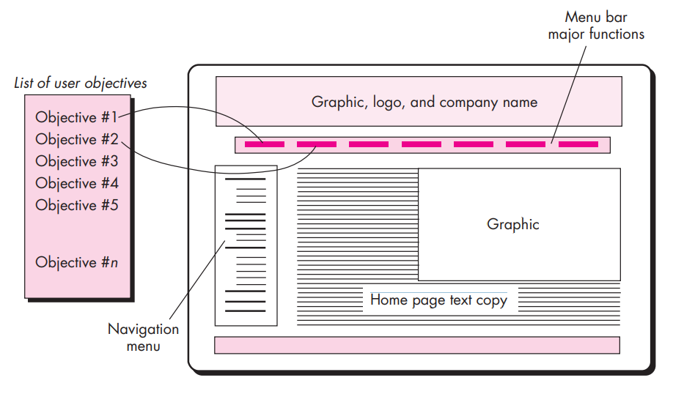
Mapping user objectives

Slide 12
Identify user interface objects
Develop a procedural representation
Develop a behavioral representation of the interface
Describe the interface layout for each state
Refine and review the interface design model
Notes:
7. Identify user interface objects
- This task may require a search through an existing object library to find those reusable objects (classes) that are appropriate for the WebApp interface. In addition, any custom classes are specified at this time
8. Develop a procedural representation
- This optional task uses UML sequence diagrams and/or activity diagrams (Appendix 1) to depict the flow of activities (and decisions) that occur as the user interacts with the WebApp.
9. Develop a behavioral representation of the interface
- This optional task makes use of UML state diagrams (Appendix 1) to represent state transitions and the events that cause them. Control mechanisms (i.e., the objects and actions available to the user to alter a WebApp state) are defined.
10. Describe the interface layout for each state
- Using design information developed in Tasks 2 and 5, associate a specific layout or screen image with each WebApp state described in Task.
11. Refine and review the interface design model
- Review of the interface should focus on usability.

Slide 13
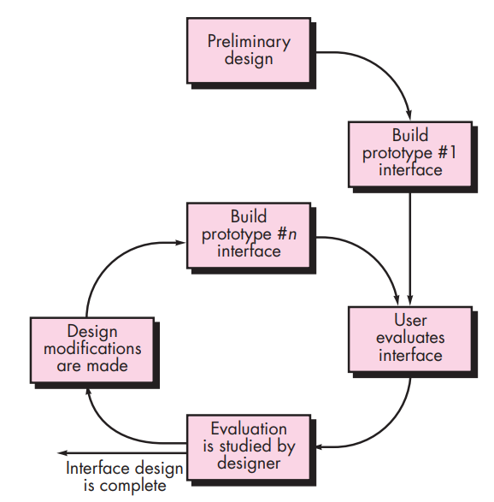
Design evaluation cycle

Slide 14
summary
The user interface is a crucial component of a computer-based system or product, and a poorly designed interface can severely hinder the user's ability to effectively use the application. Three important principles for effective interface design are: placing the user in control, reducing memory load, and maintaining consistency. An organized design process, including user, task, and environmental analysis, is necessary to achieve a successful interface. The design process includes creating user scenarios, screen layouts, and considering design issues such as response time and error handling. A prototype is built and evaluated by the user. The design of WebApp interfaces follows similar principles and workflows. The user interface is critical in shaping a user's perception of the system's quality.

